Slide 1

Presentation
Student Portfolio Website
Prepared by group 1

Slide 2
Table of content
Introduction
Objective
Flowchart
Requirement analysis
Prototype design
Testing
Future enhancement
Conclusion

Slide 3
Introduction
This project is a one-page personal portfolio website that shows a student’s profile, skills, and projects. It uses HTML, CSS, JavaScript, and PHP. The site includes a login and registration system with password reset and form validation. After login, users can edit their info, upload projects and certificates, and use a contact form to receive messages. It helps students showcase their web development skills and create a personal branding site.

Slide 4
Objective
To create a one-page website that shows a student’s personal and academic information.
To allow users to register, log in, and reset their password easily.
To let users insert their projects and certificates for viewing and management.

Slide 5
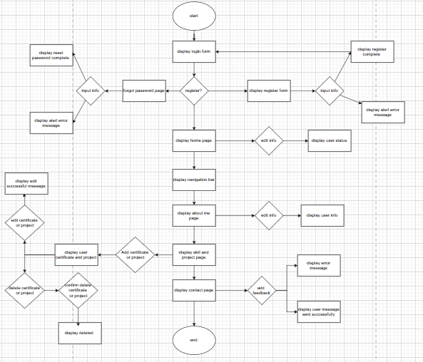
Flowchart

Slide 6
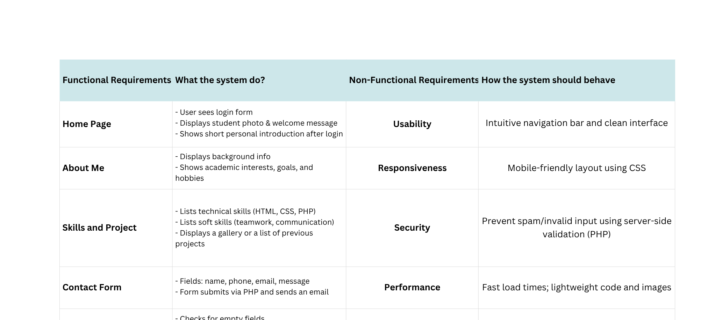
Requirement analysis

Slide 7
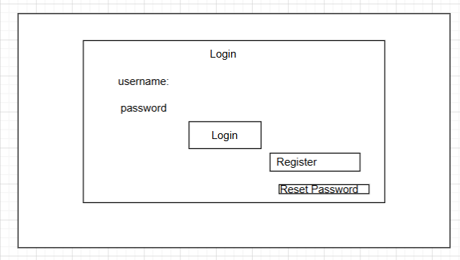
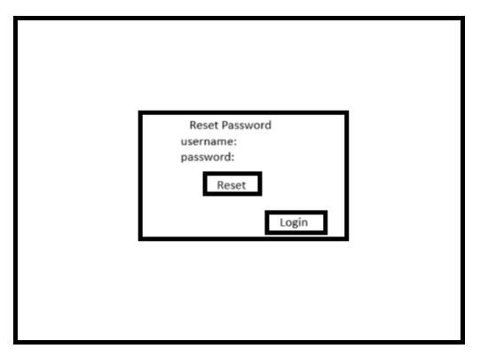
Prototype design
login page
reset password page

Slide 8
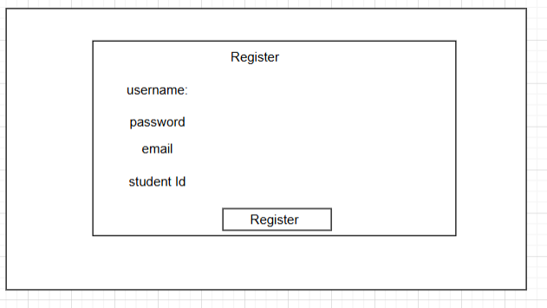
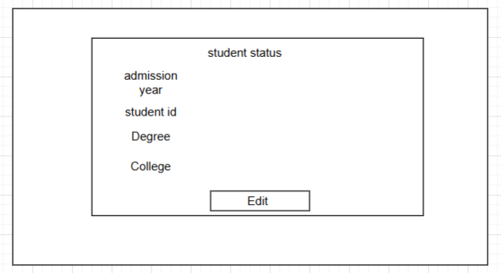
Prototype design
register page
home page

Slide 9
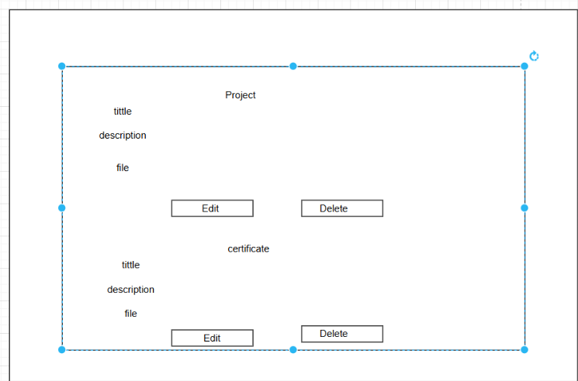
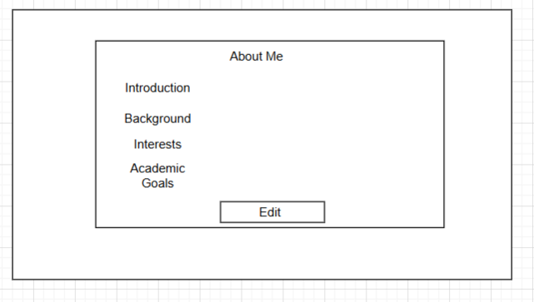
Prototype design
about me page
project and certificate page

Slide 10
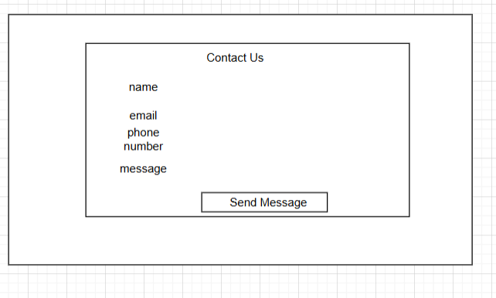
Prototype design
contact page

Slide 11
Testing

Slide 12
Future enhancement
Improve password reset by adding Student ID or Email.
Increase file upload limit to support larger files like ZIP archive
Enhance overall security and user data protection

Slide 13
Conclusion
This project gave us practical experience in web development using HTML, CSS, JavaScript, and PHP. We built a one-page portfolio website where students can showcase their background, skills, and projects. It includes login, form validation, file uploads, and a contact form. The site is interactive, easy to use, and helped us learn how to build a functional web application.

Slide 14
Thank you

